Slide 1



Chapter
2
Descriptive Statistics
© 2012 Pearson Education, Inc.
All rights reserved.
<number> of 149

Slide 2
Chapter Outline
2.2 More Graphs and Displays
© 2012 Pearson Education, Inc. All rights reserved.
<number> of 149

Slide 3
Section 2.2
More Graphs and Displays
© 2012 Pearson Education, Inc. All rights reserved.
<number> of 149

Slide 4
Section 2.2 Objectives
Graph quantitative data using stem-and-leaf plots and dot plots
© 2012 Pearson Education, Inc. All rights reserved.
<number> of 149

Slide 5

Graphing Quantitative Data Sets
Stem-and-leaf plot
Each number is separated into a stem and a leaf.
Similar to a histogram.
Still contains original data values.
26
Data: 21, 25, 25, 26, 27, 28,
30, 36, 36, 45
2
1 5 5 6 7 8
3
0 6 6
4
5
© 2012 Pearson Education, Inc. All rights reserved.
<number> of 149

Slide 6
Example: Constructing a Stem-and-Leaf Plot
The following are the numbers of text messages sent last week by the cellular phone users on one floor of a college dormitory. Display the data in a stem-and-leaf plot.
159 144 129 105 145 126 116 130 114 122 112 112 142 126
118 108 122 121 109 140 126 119 113 117 118 109 109 119
139 122 78 133 126 123 145 121 134 124 119 132 133 124
129 112 126 148 147
© 2012 Pearson Education, Inc. All rights reserved.
<number> of 149

Slide 7
Solution: Constructing a Stem-and-Leaf Plot
159 144 129 105 145 126 116 130 114 122 112 112 142 126
118 108 122 121 109 140 126 119 113 117 118 109 109 119
139 122 78 133 126 123 145 121 134 124 119 132 133 124
129 112 126 148 147
The data entries go from a low of 78 to a high of 159.
Use the rightmost digit as the leaf.
  For instance,
78 = 7 | 8 and 159 = 15 | 9
List the stems, 7 to 15, to the left of a vertical line.
For each data entry, list a leaf to the right of its stem.
© 2012 Pearson Education, Inc. All rights reserved.
<number> of 149

Slide 8
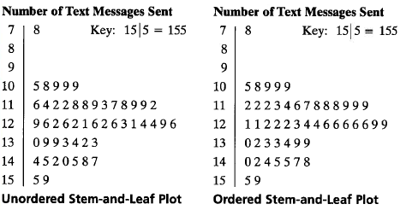
Solution: Constructing a Stem-and-Leaf Plot
Include a key to identify the values of the data.
From the display, you can conclude that more than 50% of the cellular phone users sent between 110 and 130 text messages.
© 2012 Pearson Education, Inc. All rights reserved.
<number> of 149

Slide 9
Graphing Quantitative Data Sets
Dot plot
Each data entry is plotted, using a point, above a horizontal axis.
Data: 21, 25, 25, 26, 27, 28, 30, 36, 36, 45
26
20 21 22 23 24 25 26 27 28 29 30 31 32 33 34 35 36 37 38 39 40 41 42 43 44 45
© 2012 Pearson Education, Inc. All rights reserved.
<number> of 149

Slide 10
Example: Constructing a Dot Plot
Use a dot plot organize the text messaging data.
159 144 129 105 145 126 116 130 114 122 112 112 142 126
118 108 122 121 109 140 126 119 113 117 118 109 109 119
139 122 78 133 126 123 145 121 134 124 119 132 133 124
129 112 126 148 147
So that each data entry is included in the dot plot, the horizontal axis should include numbers between 70 and 160.
To represent a data entry, plot a point above the entry's position on the axis.
If an entry is repeated, plot another point above the previous point.
© 2012 Pearson Education, Inc. All rights reserved.
<number> of 149

Slide 11
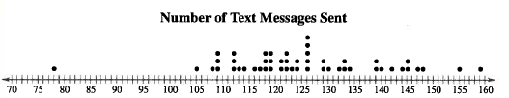
Solution: Constructing a Dot Plot
159 144 129 105 145 126 116 130 114 122 112 112 142 126
118 108 122 121 109 140 126 119 113 117 118 109 109 119
139 122 78 133 126 123 145 121 134 124 119 132 133 124
129 112 126 148 147
From the dot plot, you can see that most values cluster between 105 and 148 and the value that occurs the most is 126. You can also see that 78 is an unusual data value.
© 2012 Pearson Education, Inc. All rights reserved.
<number> of 149

Slide 12
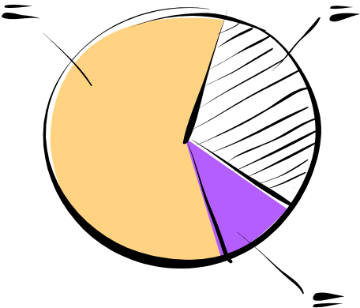
Graphing Qualitative Data Sets
Pie Chart
A circle is divided into sectors that represent categories.
The area of each sector is proportional to the frequency of each category.
© 2012 Pearson Education, Inc. All rights reserved.
<number> of 149

Slide 13
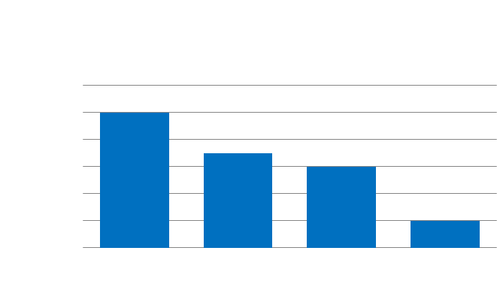
Graphing Qualitative Data Sets
Pareto Chart
A vertical bar graph in which the height of each bar represents frequency or relative frequency.
The bars are positioned in order of decreasing height, with the tallest bar positioned at the left.
Frequency
Categories
© 2012 Pearson Education, Inc. All rights reserved.
<number> of 149

Slide 14
Graphing Paired Data Sets
Paired Data Sets
Each entry in one data set corresponds to one entry in a second data set.
Graph using a scatter plot.
  The ordered pairs are graphed as
  points in a coordinate plane.
  Used to show the relationship
  between two quantitative variables.
y
x
© 2012 Pearson Education, Inc. All rights reserved.
<number> of 149

Slide 15
Section 2.2 Summary
Graphed quantitative data using stem-and-leaf plots and dot plots
© 2012 Pearson Education, Inc. All rights reserved.
<number> of 149

